Slide 1
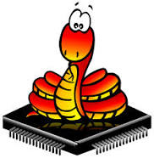

A quick introduction to MicroPython
MicroPython
https://micropython.org
Wouter van Ooijen
wouter.vanooijen@cboost.nl

Slide 2
Me
TU Delft Informatica 1988
ICT Automatisering
Product: VAX11 industrial datacommunication
@ Fokker Space / Ducth Space: Era Robotic ARM
@ Hollandse Signaal / Thales: SmartNet ATM comms system
VOTI webshop, self-employed (NLR), projects
Hogeschool Utrecht: lecturer Technische Informatica
Cboost: embedded specialist
Wouter van Ooijen
wouter.vanooijen@cboost.nl
Programmer by profession, electronics tinkerer by passion

Slide 3
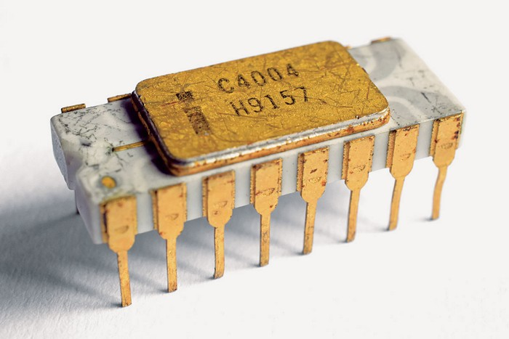
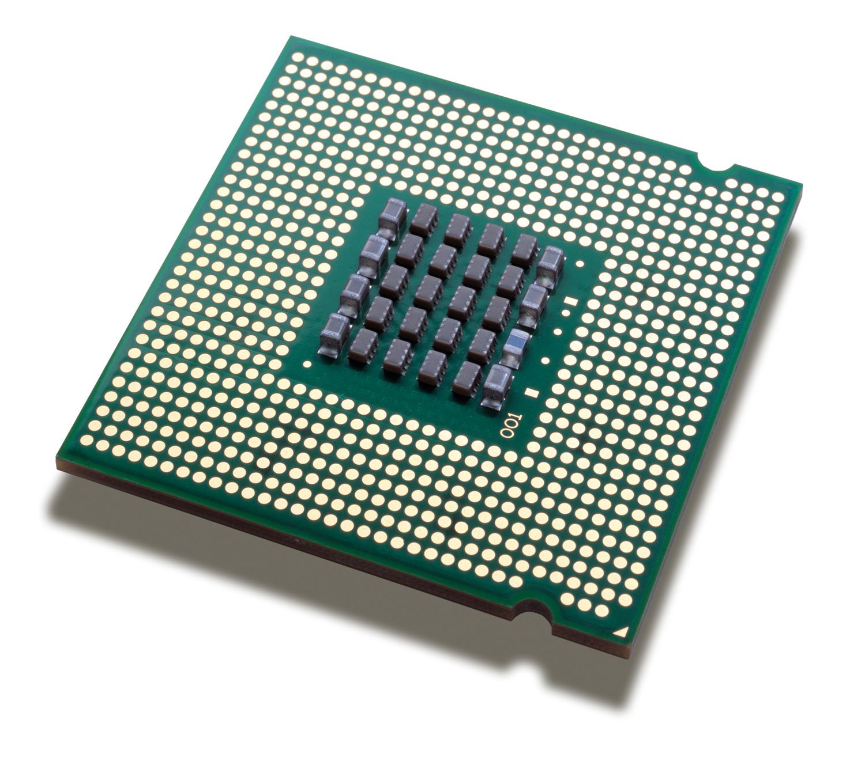
A micro-processor
1971
0.1 MIPS
4 bits
A micro-processor is:
CPU only
What is in your desktop, laptop, server, mobile
$$$
Optimized for processing power
Uses external ROM, RAM, peripherals, ...
Needs LOTS of power (and often cooling)
faster
2022
300 GIPS
64 bits

Slide 4
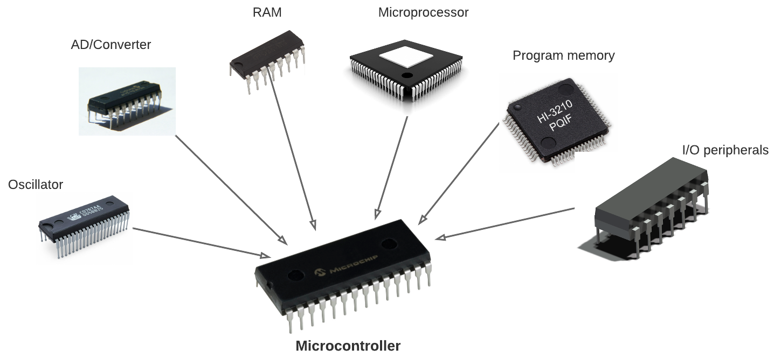
A micro-controller
1971
CPU
A micro-controller is
A single* chip with CPU, RAM, FLASH, I/O, …
Cheap, small, low-power
Used for embedded, real-time
(Much) less resources than a desktop
What you find in almost everything that is not a computer
Include more
2022
CPU, MMU
ROM, RAM
GPIO, A/D, D/A
I2C, SPI, I2S
….
* Next slide

Slide 5
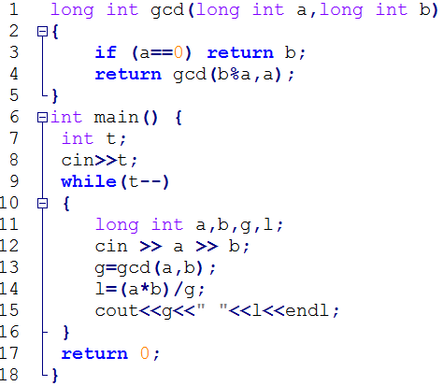


Interpreter
Interprets
Runs
Source code
Interpreter
CPU
interaction

Slide 6
Compiler
Translates
Runs
Source code
Compiler
Runs
CPU
interaction
Application

Slide 7
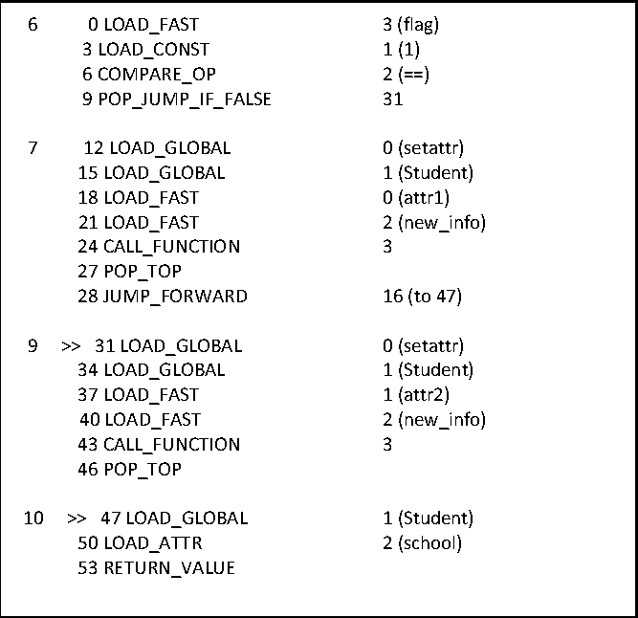
Compiler / Interpreter
Compiler
Translates
Runs
Source code
Runs
CPU
Interprets
interaction
Intermediate code
Interpreter / Virtual Machine

Slide 8
Compiler ⬅➔ Interpreter
Compiler translates (and validates)
Processor or interpreter executes the result of the translation
High-performance languages (typically) compile to CPU instructions (‘run native’)
Python (typically) compiles to Python byte-code
Which is then interpreted by the Python byte-code interpreter

Slide 9

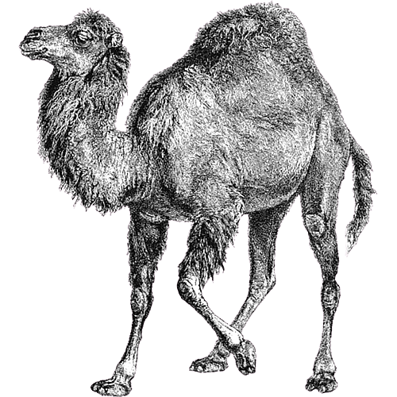



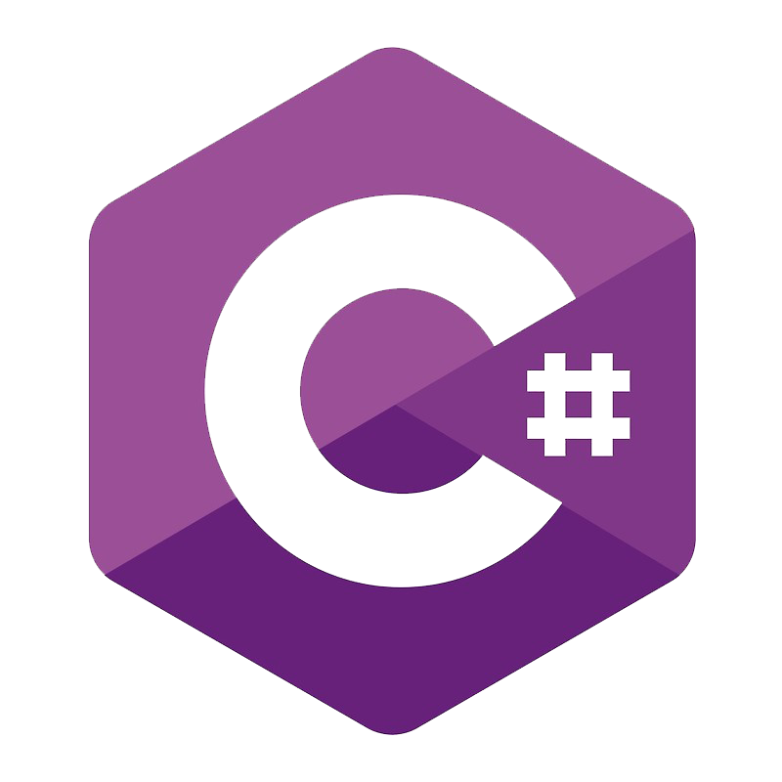


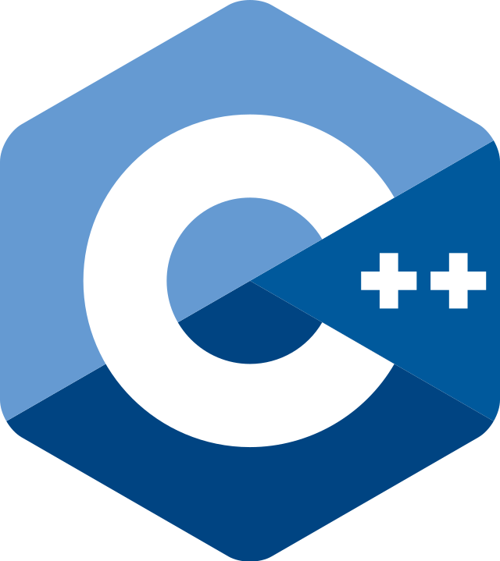




Python’s place
Run-time typed, memory managed ‘scripting’ languages:
Make it easy to do things that ought to be simple.
The programming language for the rest of the population.
Programming for non-programmers.
Get results quickly.*
(at the cost of run-time performance)
Not ideal for larger applications.
High-performance languages (C, C++, Rust, Ada, FORTRAN, …):
Get the best run-time performance
Optimize for large, complex applications.
(at the cost of programmer education, coding/debugging time)

Slide 10

3 broad types of languages
Writes faster, easier on small programs
Typing | Run-time |  |  | Compile-time
Compiles to | Intermediate (interpreter) |  |  | Native (CPU)
Memory Management | Automatic (run-time) |  |  | Manually (programmer)
Runs faster, easier on large programs

Slide 11

(C)Python
Source code
CPU

Slide 12

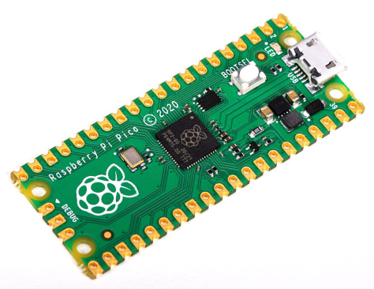
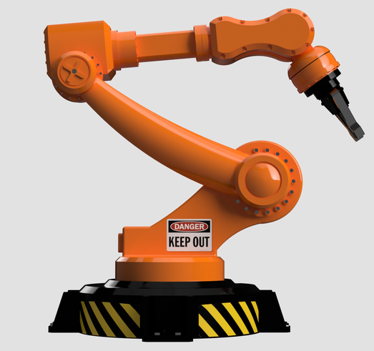
MicroPython
Thonny
Desktop CPU
On the PC
REPL
On the MC
MicroController
MicroPython

Slide 13
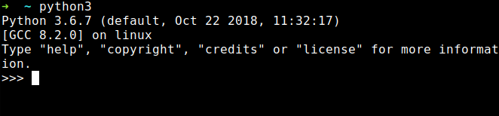
(Micro)Python REPL
Read-Evaluate-Print Loop:
Connects to your PC via serial-over-USB
Read your input
Evaluate (run) it
Print the result
Repeat this forever
Acts as a primitive Operating System command interpreter
Provides a simple file system
Can interrupt a running program

Slide 14
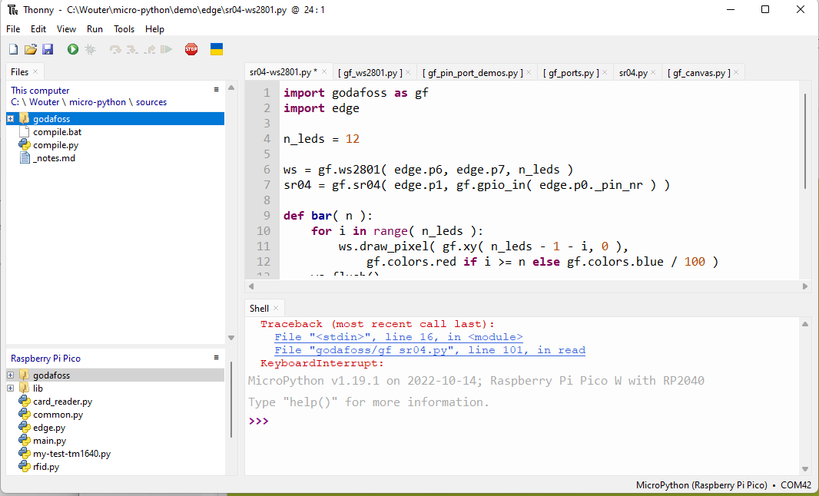
Thonny
Simple Python edit-run IDE
Can be configured to run remotely via REPL over (USB-) serial
Has very simple but useable file system views, with upload / download
Can directly install MicroPython on some target chips
Editor is a bit primitive (I prefer Notepad++ for serious editing work)

Slide 15
Demo install
Install by hand:
Connect Pi Pico USB while button pressed
D: drive shows up in explorer
Copy MicroPython image file to D:
Install using Thonny:
Again, Connect Pi Pico USB while button pressed
InThonny: Tools → Options → Interpreter
→ Select MicroPython (Rasberry Pi Pico)
→ Install or update MicroPython, variant H or HW
In thonny:
print ( “Hello” )

Slide 16
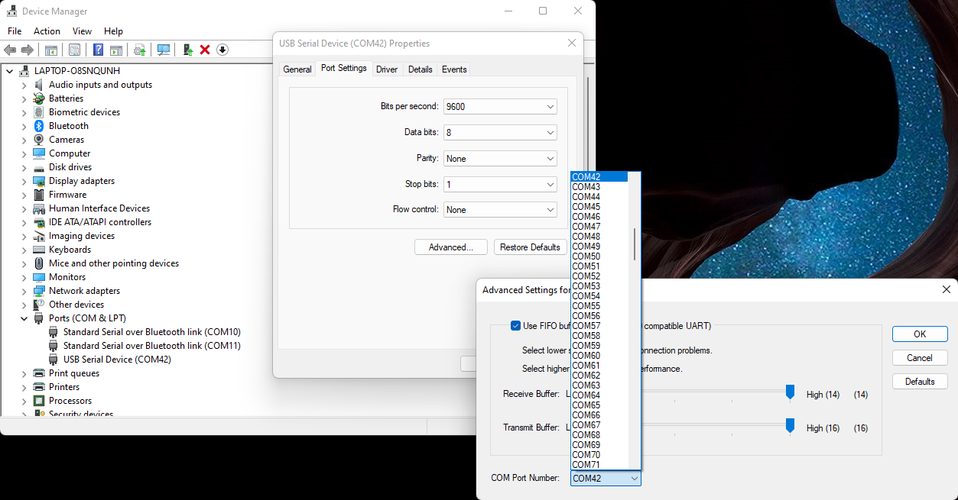
(rename serial port)

Slide 17
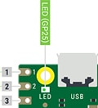
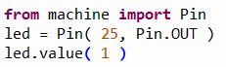
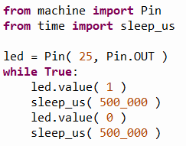
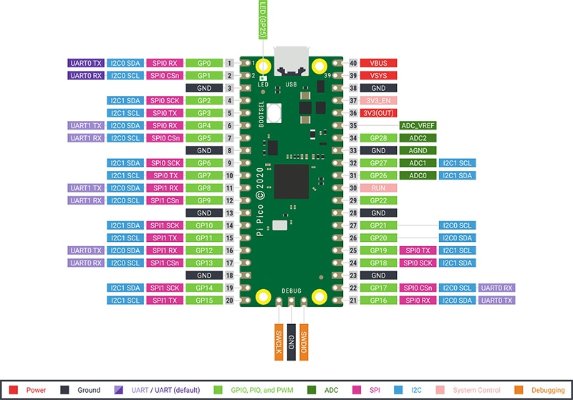
Demo blinky
In Thonny REPL:
In Tonny editor:

Slide 18
Startup
boot.py runs first (at reset or power-up)
REPL STOP is a reset, and re-runs boot.py,
keyboard interrupt doesn’t re-run boot.py
Don’t mess with boot.py unless you really know what you are doing
main.py file runs after boot.py
REPL STOP doesn’t re-run main.py
keyboard interrupt doesn’t re-run main.py either
Put your startup line (import myapp.py) in main.py

Slide 19
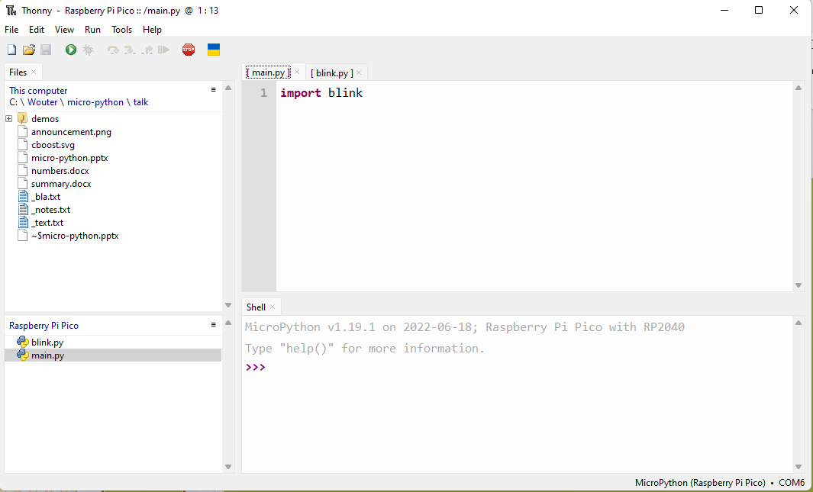
Demo startup
Save blink.py on the target
Create main.py on the target
Connect to power bank

Slide 20
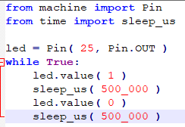
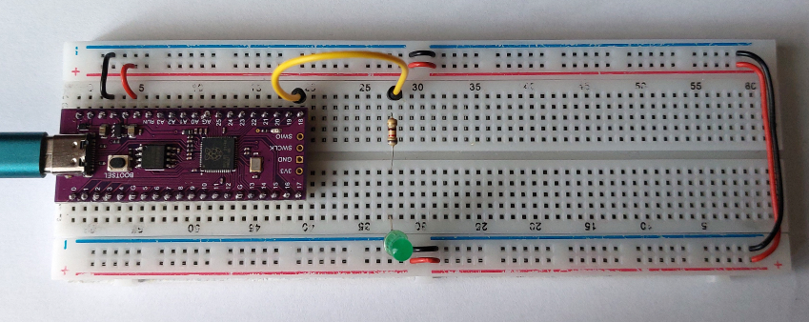
Demo breadboard blinky

Slide 21
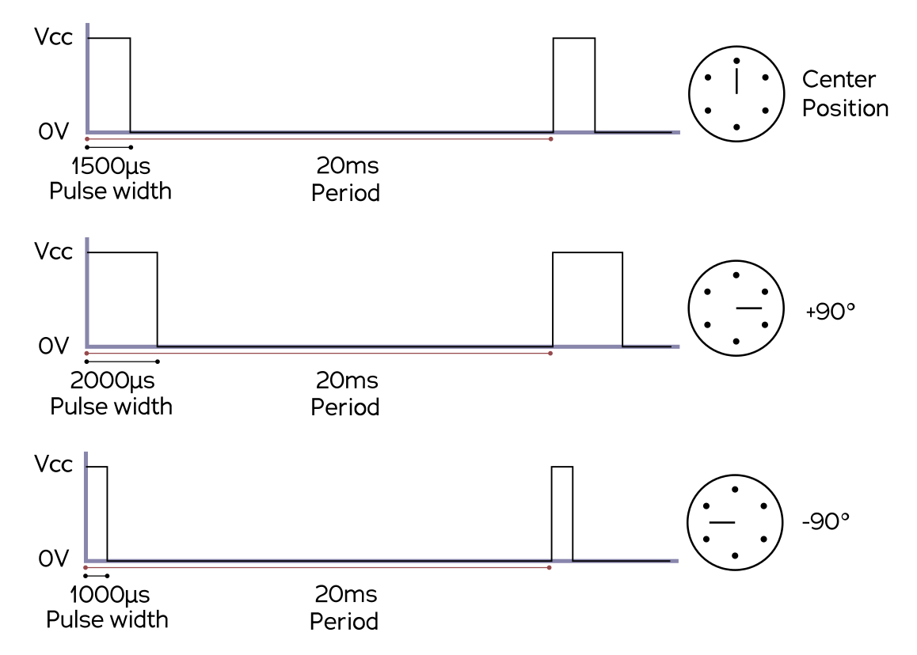
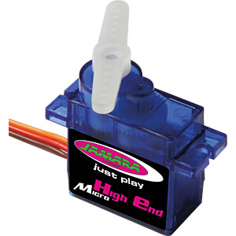
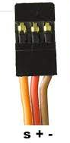
Servo control

Slide 22
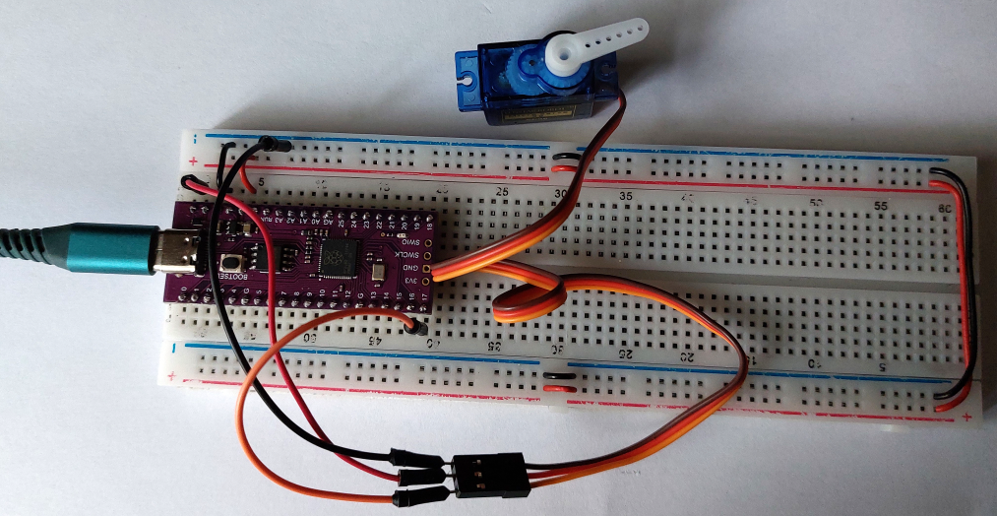
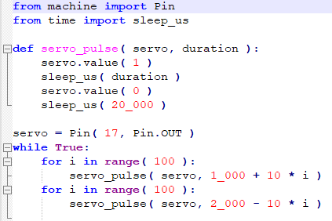
Demo servo

Slide 23
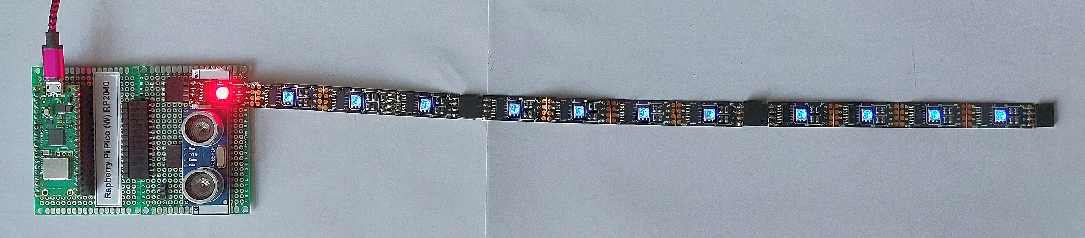
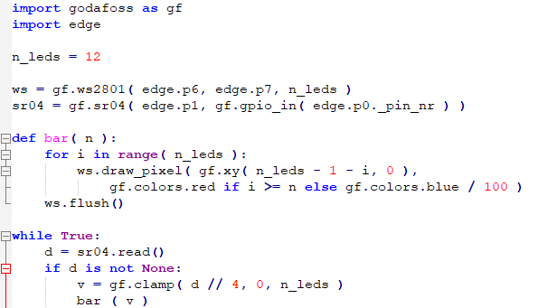
Demo SR04

Slide 24

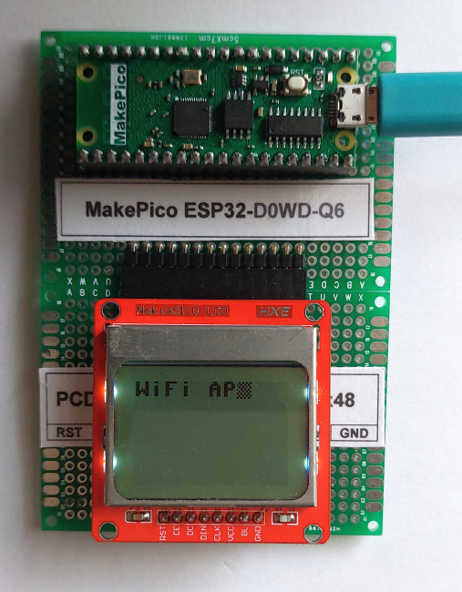
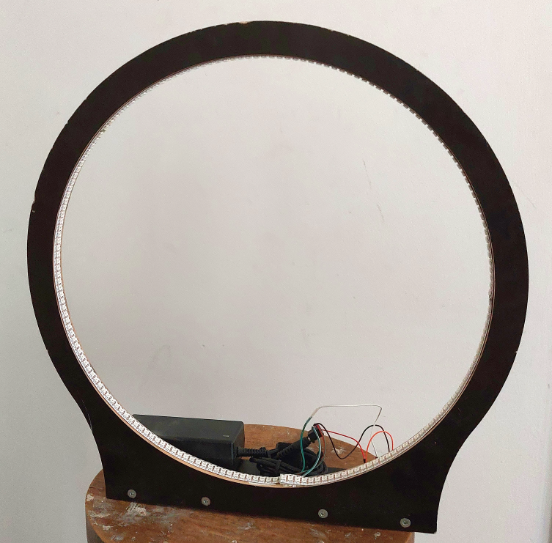
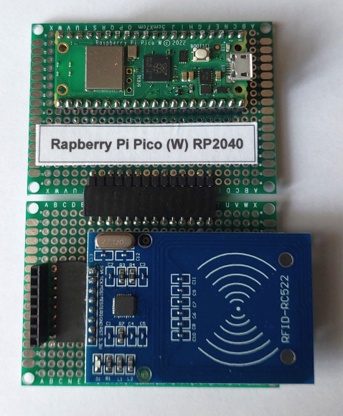
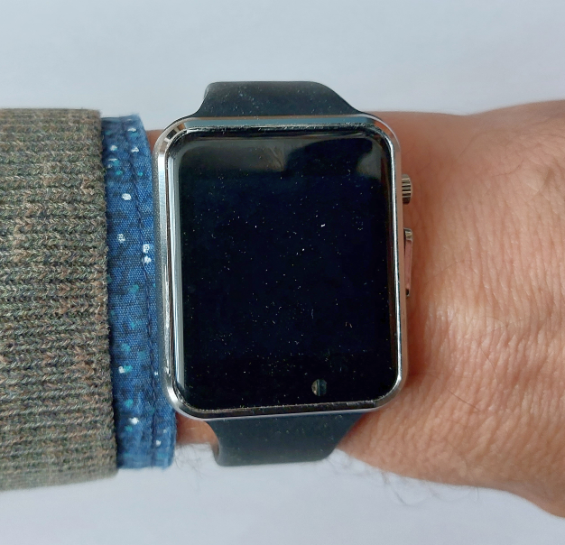
Demo neopixels & WiFi
Access point
MakePico ESP32
(Tensilica)
Neopixels
Micro ESP32-C3 (RISC V)
RFID card reader
Pi Pico W (Cortex-M)
LilyGo TTWatch V3
ESP32 (Tensilica)

Slide 25
Some target Chips/Boards
name | price | RAM | FLASH | Clock MHz | RAM free | Flash free | Wireless | Notes | Conclusion
Nano 33 BLE | 35.00 | 256 kb | 1 Mb | 64 | ? | ? | B | peripherals | No REPL
Teensy 4.1 | 36.00 | 1 Mb | 8 Mb | 600 | 744 Kb | 7 Mb | - | I/O | Spacy, -W -B
Pi Pico | 5.00 | 264 Kb | … 16 Mb | 133 (2) | 185 Kb | 1.4 Mb | - | PIO | OK
Pi Pico W | 8.00 | 264 Kb | … 16 Mb | 133 (2) | 159 Kb | 848 Kb | W (B) | PIO | OK, preferred
ESP32 | 7.00 | 320 Kb | … 16 Mb | 160/240 (2) | 106 Kb | 2 Mb | W, B |  | OK
ESP32 spiram | 7.00 | 8 Mb | … 16 Mb | 160/240 | 4086 Kb | 2 Mb | W, B |  | OK
ESP32 C3 | 7.00 | 400 Kb | … 16 Mb | 160 | 122 Kb |  | W, B |  | OK
ESP8266 | 5.00 | 80 Kb | … 4 Mb | 80/160 | 33 Kb | 3 Mb | W, B |  | Limited, use .mpy
micro:bit v1 | Obsolete | 16 Kb | 256 Kb | 16 + | 7 Kb | ~ 30 Kb? | W, B | no .mpy, dirs | Toy
micro:bit v2 | 18.50 | 128 Kb | 512 Kb | 64 + | 62 Kb | ~ 30 Kb? | W, B | no .mpy, dirs | Toy
W600 | 2.00 | 288 Kb | 1 Mb | 80 | 32 Kb ? | 32 Kb ? | W |  | Thonny errors
Kendrite K210 | 40.00 | 8 Mb | 16 Mb | 400 (2) | 2320 Kb | 0 | - | No flash? | Thonny errors

Slide 26
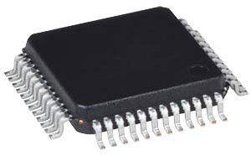
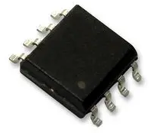
Still a micro-controller?
CPU, MMU
RAM, FLASH
I/O, other peripherals
CPU, MMU
RAM, small FLASH
I/O, other peripherals
Large external Flash
Traditional single-chip micro-controller
‘micro-controller’ with external FLASH chip
AVR, PIC, most Cortex
ESP8266, ESP32, RP2040
FLASH and general logic require different (optimal) chip processes

Slide 27
Limitations
Uses a lot of RAM, especially for graphics
Speed is low (compared to running native code) and can be unpredictable
Some timing-based HW interface protocols (neopixels, dallas one-wire, DHT11) are not feasible in native Python
Some doubts about running longer time (memory fragmentation), needs occasional 2nd start ☹
Needs more expensive hardware (than a native-code application)
Might use more power (than a native-code application)
Organization is MUCH smaller than python.org (hobbyistic)
Some standard libraries are not available and/or impractical (CPU & memory load)
Not all ports are equal (especially in WiFi details and built-in HW libraries)
No multi-threading (except when multiple CPUs are available)
Type hints don’t seem to be implemented

Slide 28
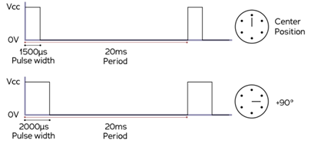
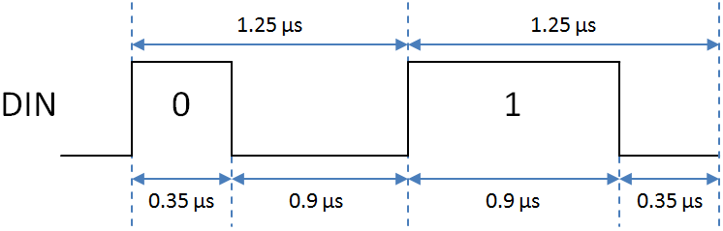
Timing / performance
How much time do you have to do something simple?
1’s of clock cycles: hardware peripherals, assembler, RP2040 PIO’s
10-100’s of clock cycles : C, C++, Rust
1000’s of clock cycles: MicroPython
Servo: 1000 – 2000 µS
Neopixel: 0.35 – 0.9 µS

Slide 29
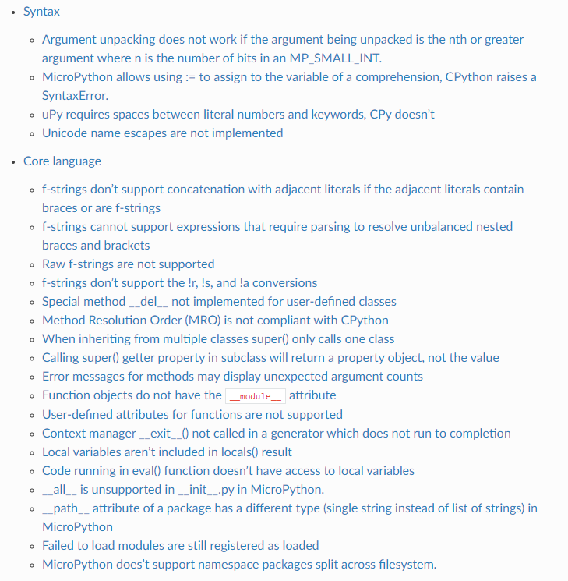
Deviations from CPython
Source: https://docs.micropython.org/en/latest/genrst

Slide 30
Application areas
Faster development outweighs extra hardsware
Tinkering (hobby, education, exploratory work, lab setting)
Prototyping, proof-of-concepts
Testing
Small series
When a knowledgeable end-user must do some configuration

Slide 31
Caveats
Some chips claim MicroPython support but don’t fully deliver (W600, K210).
Be sure to save your work on your PC (too)!
An uploaded file is sometimes not recognized as newer (solution: add a space and download)
Thonny sometimes crashes (especially on communication problems – don’t pull the cable!)
During import, the *source* of the module must fit in RAM, so large files might need to be split up
Different MicroPython versions and ports can be subtly different

Slide 32
Not discussed
Wireless REPL (WiFi)
Embedding native code in the interpreter
Thonny alternatives
Pre-compiling (also to protect your IP) with mpy-cross
CircuitPython: proprietary variation by AdaFruit, very similar but some irritating differences

Slide 33
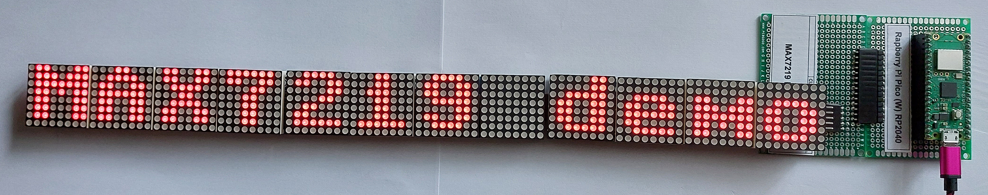
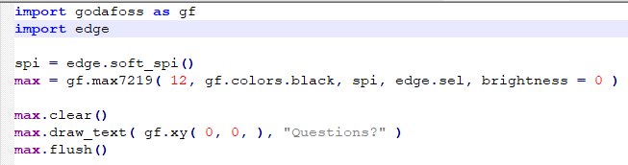
Max7219 demo

